Slide 1

WEB SCRAPPING AND DATA ANALYSIS ON WASHING MACHINES
Sub Titile
This Photo by Unknown Author is licensed under CC BY-NC-ND

Slide 2
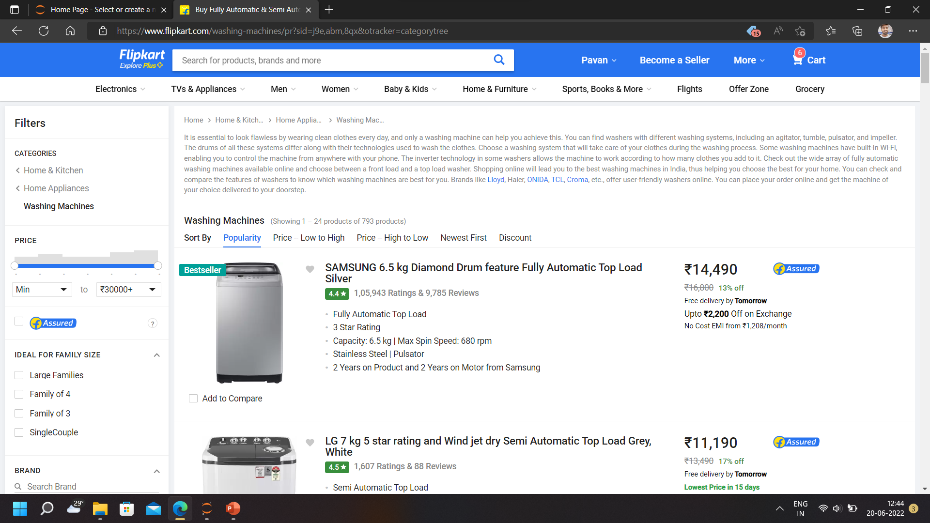
website:

Slide 3
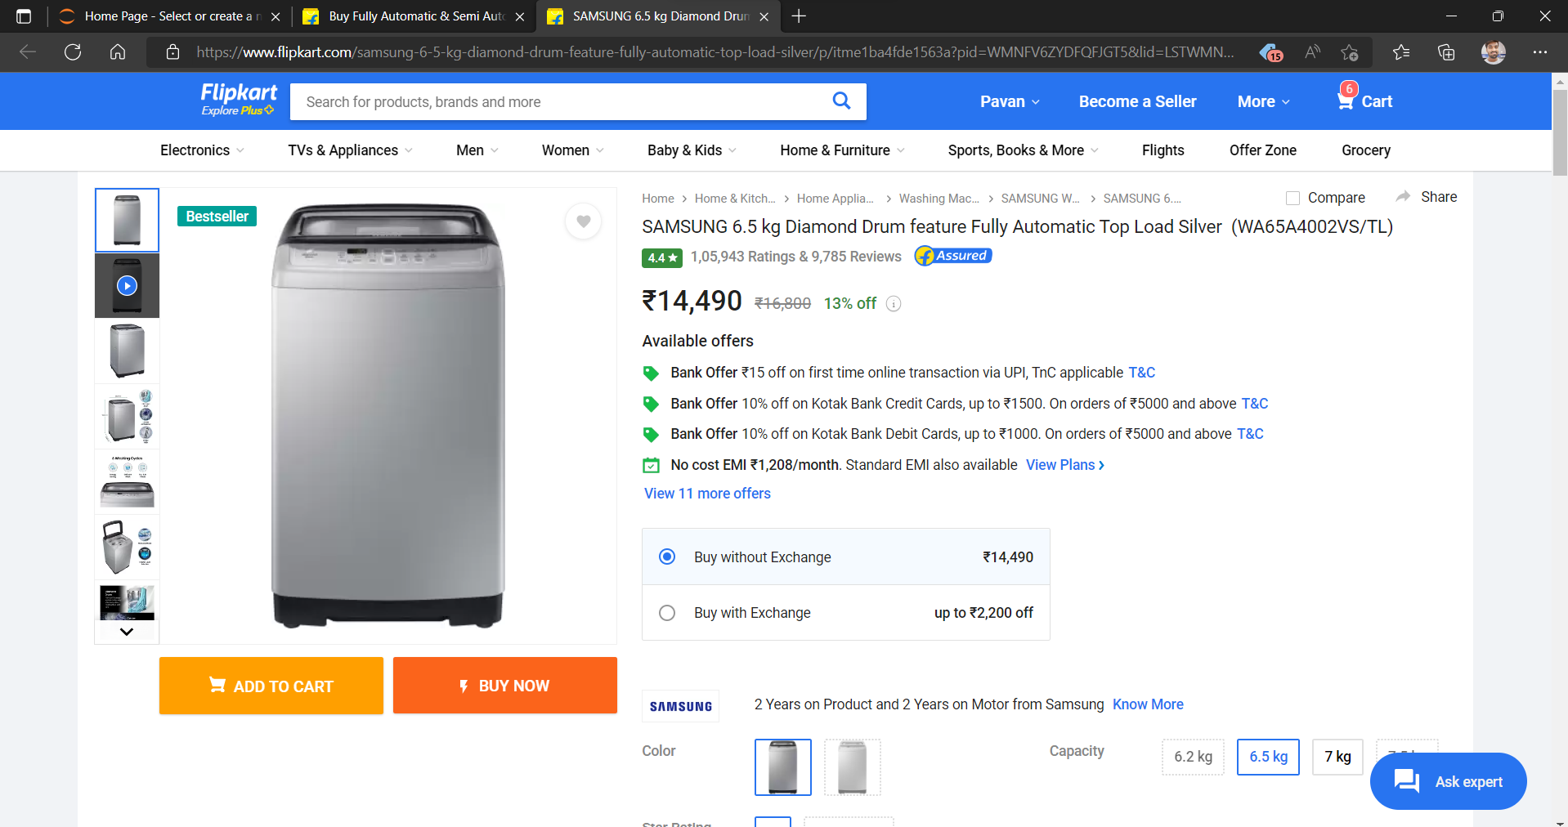

Slide 4
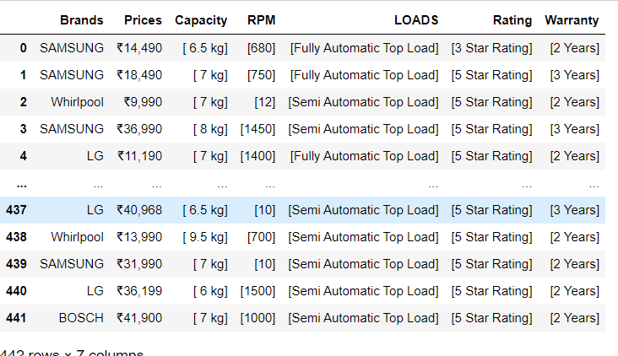
RAW DATA:

Slide 5
ANALYSIS :
Identified Null Values.
Identified Missing Values.
Treating rows and columns with null values and missing values.
Extracting required data from columns to create another columns using regular expressions.
Treating columns and converting required columns from object to int or float datatype.

Slide 6
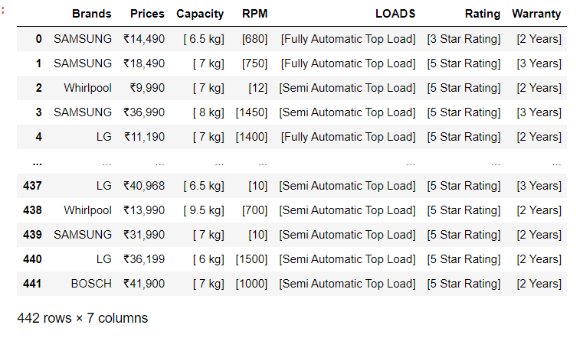
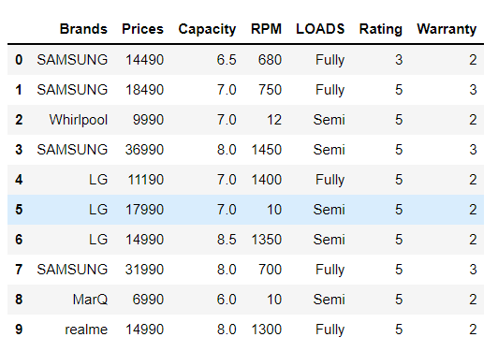
BEFORE CLEANED
AFTER CLEANED

Slide 7
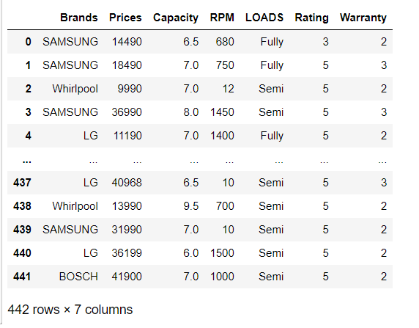
DATAFRAME AFTER CLEANING

Slide 8
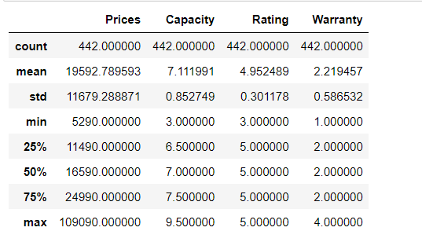
Summary statistics of Data Frame:

Slide 9
Customer 1 : I need a best washing in between 20000 to 25000 with 6 to 7.5 kgs of capacity
Customer 2: I need a Washing machine under 25000 with Fully loaded only in IFB brand
Customer 3: I need a washing machine under 10000 only in Samsung with 7.5 kgs of capacity and semi loaded with 2 years of warranty

Slide 10
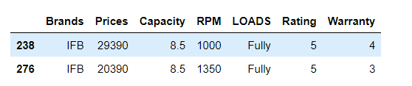
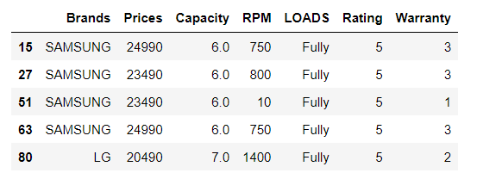
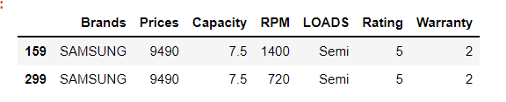
CUSTOMER 1
CUSTOMER 2
CUSTOMER 3

Slide 11

VISUALIZATION

Slide 12
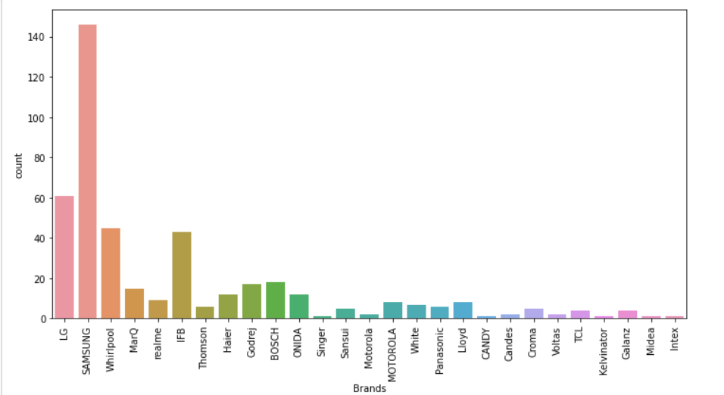
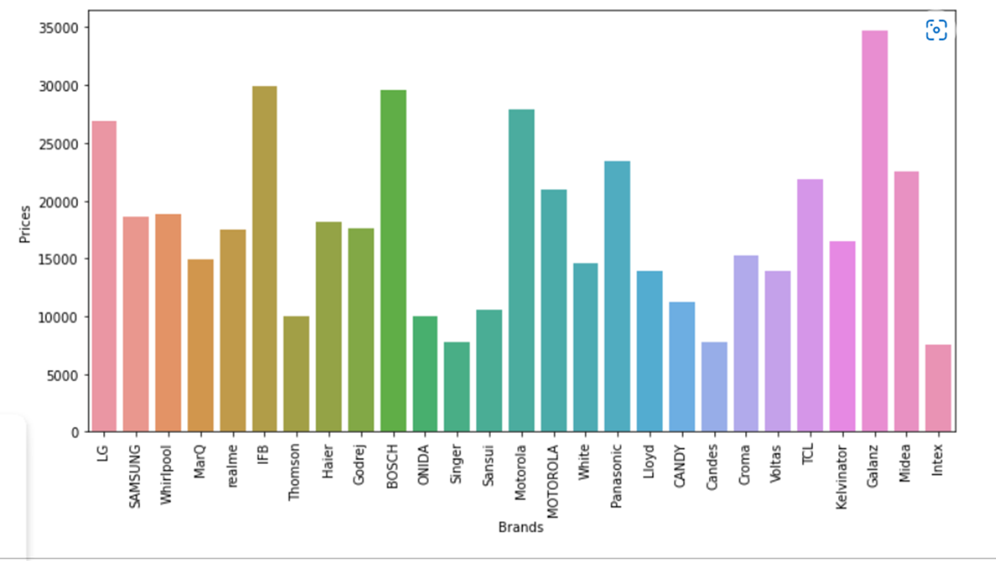
1.IN between brands and count SAMSUNG & LG has more number of models in Washing Machines by using this plot
2. According to this GALANZ washing machine has 35000 price and average is IFB and BOSCH.
harshitha####

Slide 13
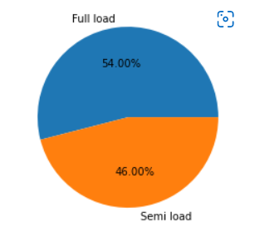
According to this plot Fully-load has more percentile than Semi-load

Slide 14
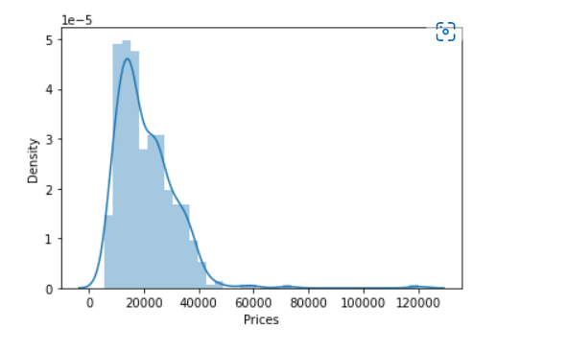
Prices are positively increased in between 10000 to 40000 towards right hand side

Slide 15
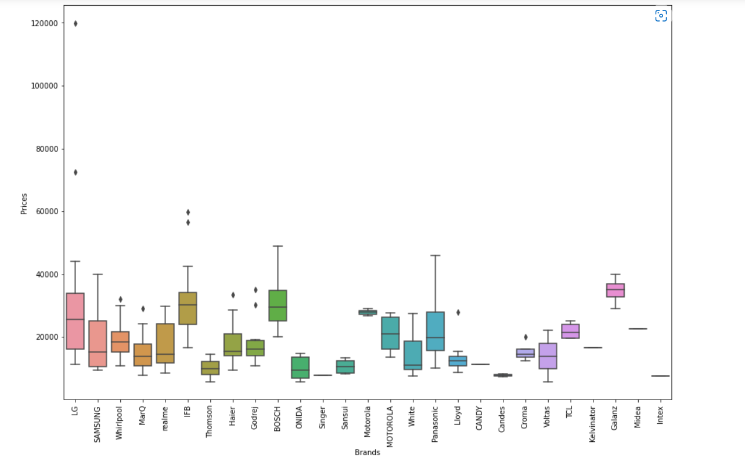
Brands and Price relation analysis
More no of outliers is for IFB and LG Brands

Slide 16
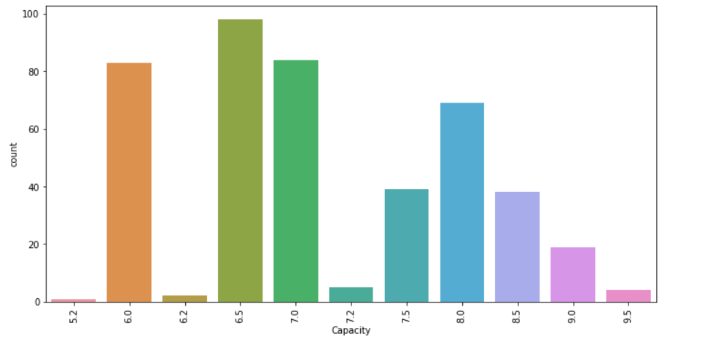
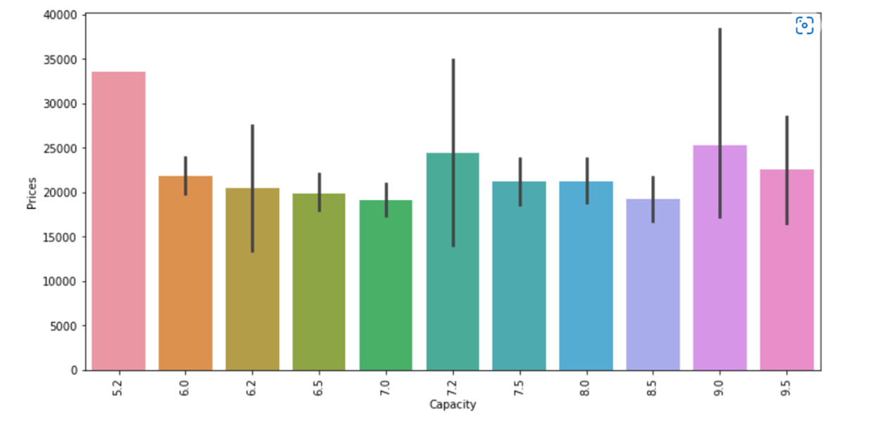
In between 6.0 and 7.0 capacity we have more no of washing machines upto 90 .
In between capacity and prices at 5.2 kgs of capacity price of washing machine is 34000 at 9.0 kgs of capacity price of washing machine is 25000 to 27000

Slide 17
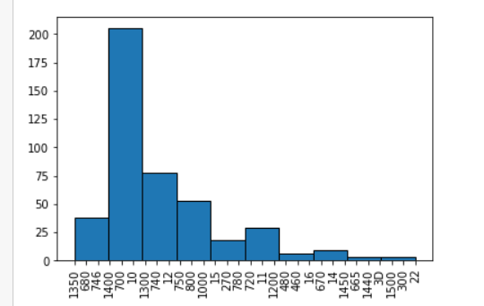
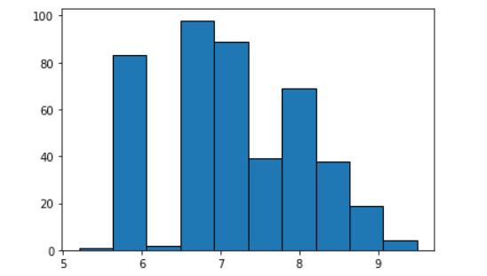
In this plot RPM is more from 700 to 1300 and no of washing machine is 200
In this plot capacity in between 6.5 to 7.0 is high and no of count is 80-95 machines

Slide 18
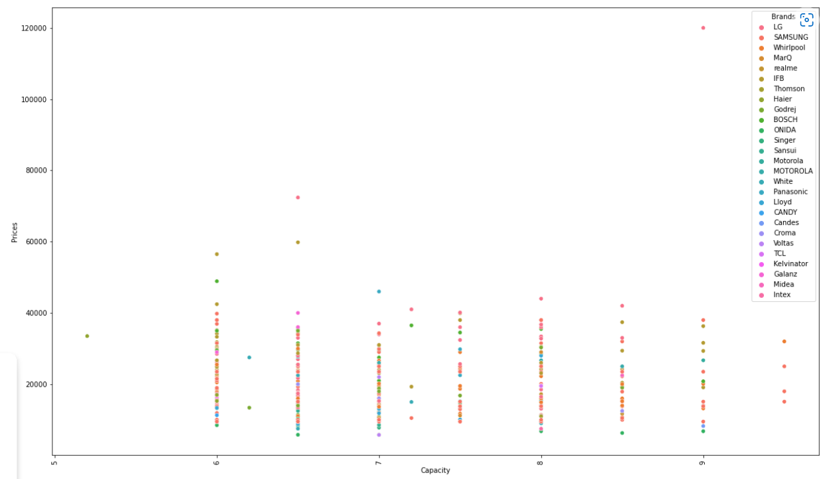
According to scatter plot average between 6.5 capacity at price of approx. 70000 is GALANZ
9 kgs of capacity is high in Washing Machines

Slide 19
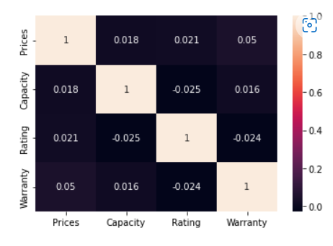

Slide 20
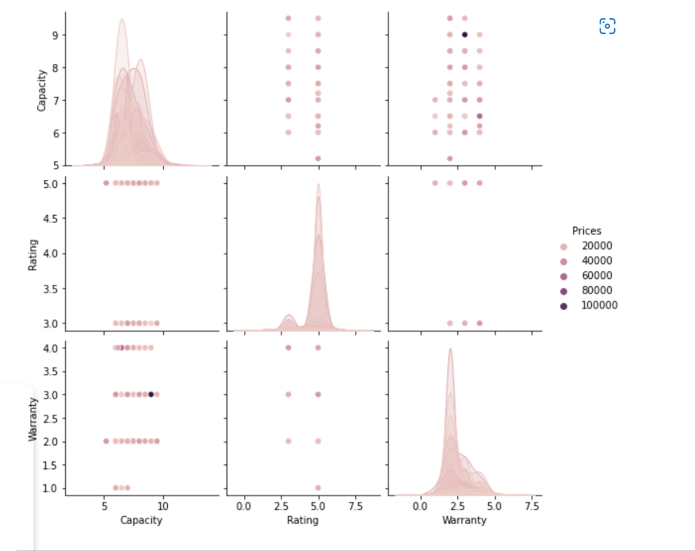
Multi variant Analysis :

Slide 21
CONCLUSION :
1.Acording to conclusion IFB is the best at 8.5kgs of Capacity and price is upto 30000
2. Compared to IFB Samsung has less price with 7.5 kgs capacity and warranty is less compared to IFB
* But finally IFB is the best model to buy washing machine under 30000 with best warranty and best capacity

Slide 22
Key take aways:
From Flipkart URL I Scraped a data and used Washing Machines
Libraries imported
Data frame creation
Data cleaning
Data frame after cleaning
Summery statistics
Univariate analysis
Bi variate / multivariate analysis
conclusion

Slide 23

PROJECT NAME :
ANALYSIS ON WASHING MACHINES
PRESRENTED BY : S.PAVAN KUMAR
QUALIFICATION :
BTECH(ELECTRICAL AND ELECTRONICS ENGINEERING )

Slide 24


